Slide 1
EECS 370
Lab 2: Project 1 - LC2K ISA

Slide 2
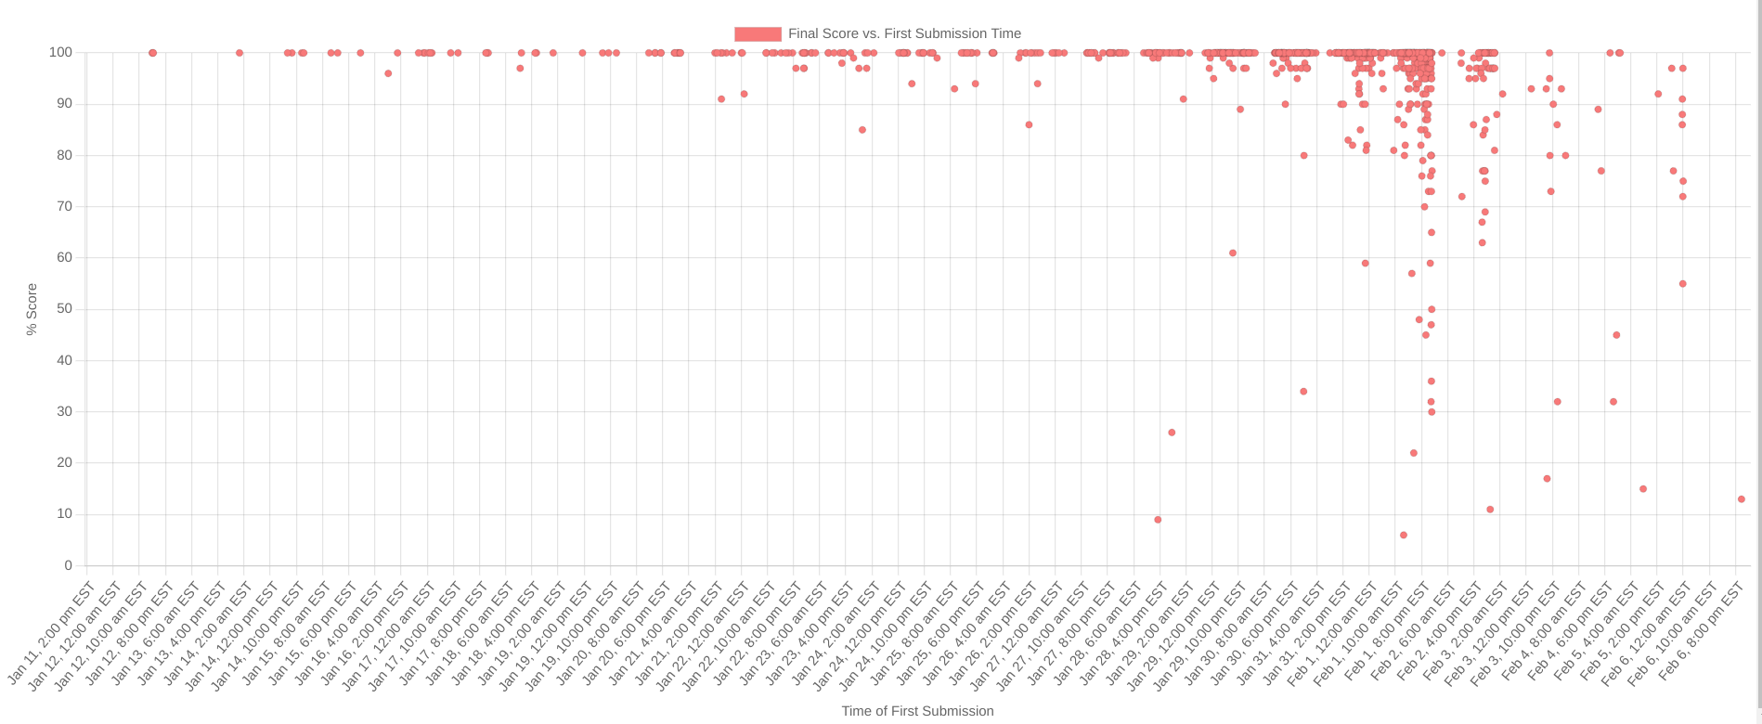
Upcoming Assignments
Project 1a due Thursday September 11th
Score distribution with late days from W24:

Slide 3
Today’s Discussion
More on Binary: 2’s complement & multiplication
How to translate to LC2K
How to write in LC2K

Slide 4
Lab Format
Most labs will contain a brief review of relevant info
You will be given problems to work on 1 at a time in your group
Some will be hand-written, some will be submitted to the autograder
Turn in hand-written components together and in-order once you finish
AG components must be submitted by Thursday, but expected to submit in-lab
Groups are self-formed today (I will help find you a group if needed)
We will assign permanent groups for the next lab onwards
You must stay until your group submits to receive credit
We may change this during the semester, we are experimenting with formats

Slide 5
Admin Form
Sick or known conflict with future lab?
Please fill out admin form linked on course website before your lab meets
Everyone gets a free lab drop, but it will help to have a record in case extenuating circumstances force you to miss multiple labs

Slide 6
Problem 1
Introduce yourself to your group mates if you haven't already
Discuss this questions on tradeoffs of registers (repeated on next slide)
Review slides from lectures 2/3 if needed
Note for #4, we mean the number of operands that can be simultaneously used in an instruction, not the range of operands
Have one member write-down your answers on provided sheet
Recommend rotating who this person is across problems
We'll give you about 10 minutes to discuss and write your answers
(Hold on to your answers until you are done with the whole lab)

Slide 7
Problem 1
Is the following a valid advantage of increasing the number of registers?
Increasing the number of registers generally reduces the number of instructions needed to implement a C program.
Increasing the number of registers reduces the number of memory accesses (i.e. loads and stores) needed to implement a program.
Increasing the number of registers reduces the size of each instruction.
Increasing the number of registers allows for a larger number of operands to be used in a single instruction.
Notes:
Staff directions: give 10 minutes if needed before moving on to next slides

Slide 8
Review from Lab 1:
Expanded Form for Binary and Decimal
 | Decimal | Binary | Hex
Digits | 9 4 | 1 0 1 1 1 1 0 | 5 E
Values | 10¹ 10⁰ | 2⁶ 2⁵ 2⁴ 2³ 2² 2¹ 2⁰ | 16¹ 16⁰
Conversion Back to Decimal | 9*10¹ + 4*10⁰ = 94 | 2⁶ + 2⁴ + 2³ + 2² + 2¹ = 94 | 5*16¹ + 14*16⁰ = 94

Slide 9
Negative Numbers Using 2’s Complement
A way to represent integers using binary, both positive and negative
In 2’s Complement, the most significant bit (MSB) is negative
For example, in a 4-bit number, the MSB typically represents 2³, but in 2’s Complement, the MSB instead represents -2³
So, if the MSB is 0, the number will be positive (or zero) And, if the MSB is 1, the number will be negative
The other bits remain the same, let’s see how with an example:

Slide 10
Converting 3₁₀ into -3₁₀ with 4-bit Integers
With a 4-bit, 2’s Complement, binary number, we represent 3 as
0011₂ -> 0(-2³) + 0(2²) + 1(2¹) + 1(2⁰) = 3
Conversely, we represent -3 with the same constraints as
1101₂ -> 1(-2³) + 1(2²) + 0(2¹) + 1(2⁰) = -3
To convert quickly and easily, flip the bits and add 1!
3 = 0011 -flip-> 1100 -add1-> 1101 = -3

Slide 11
Problem 2: Number of 1’s
This problem will help us practice with checking if each bit is a 1.
Implement the C function int numHighBits(int number) and write your solution on the provided sheet. It should return the number of bits that are set to one in the binary representation of the input number. You should use sizeof to determine how many bits the input is on the given system.
For example, an input of 23 should return 4 since 23 equals 0b10111, which has 4 one bits. Use sizeof to determine how many bits are in an int (it varies across machines!)
Remember that integers use 2’s complement! We'll give you about 15 minutes
Notes:
Staff directions: give ~15 minutes before moving on to next slides

Slide 12
LC2K ISA

Slide 13
LC2K: The add Instruction
The add instruction allows us to do some bit shifting:
x + x == x * 2 == x << 1
By doing this multiple times, we get multiplication:
a * 2^{b} == a << b

Slide 14
LC2K: The nor Instruction
NOR in LC2K is bitwise: First do OR with A | B, then NOT with ~result.
Recall from 270 or 203 that NOR is a universal gate; any gate can be built from it (AND, OR, etc.) https://en.wikipedia.org/wiki/NOR_logic
~A = ~(A | A) = NOR(A, A) Since A = A | A
A | B = ~(~(A | B)) = ~(NOR(A, B)) Double Negation
A & B = ~(~A | ~B) = NOR(~A, ~B) By DeMorgan’s Laws

Slide 15
Combining add and nor
We can do subtraction by combining them:
A - B = A + (-B) = A + (~B + 1)
We can set or mask bitfields, like in Lab 1:
First shift with multiple add instructions, then do some nor operations.
How can you use this in your multiplication algorithm?
Notes:
First shift with multiple add instructions (create mask or set bitstring), then do some nor operations (perform bitwise AND for masking or bitwise OR for setting).

Slide 16
LC2K: The beq Instruction
beq always branches (sets PC) to PC + 1 + offset.
But if the offset is a label, it just branches to the label.
Review lec 4/5 & P1 Walkthrough for examples, and be comfortable with:
If/Else statements
While Loops
Do-While Loops
For Loops

Slide 17
The beq Instruction
beq instructions implement conditional branches, but how do we do unconditional branches like in ARM?
When the 2 registers in beq are the same register, the branch is unconditional.
Example: beq 1 1 offset is unconditional since r1 = r1 always.

Slide 18
Testing Project 1a
There are 2¹⁰ (add, nor) + 3*2²² (lw, sw, beq) + 2⁶ (jalr) + 2 (noop, halt) = 12,584,002 possible LC2K instructions.
You cannot test all of these!
But, you can test every opcode, regA, regB, and destReg.
You should also test many types of offsets and .fill values:
Numbers (16-bit 2’s complement)
Absolutely-resolved labels for lw/sw/.fill
Relatively-resolved labels for beq

Slide 19
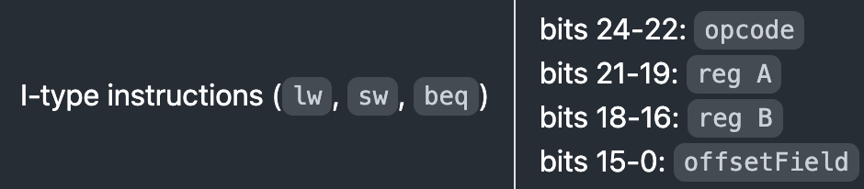
LC2K to Machine Code Conversion Example
“five” is defined on line 8 (address 7) so memory[7] = 5
From spec.as
lw 0 1 five load reg1 with 5 (symbolic address)
0000 0000 1000 0001 0000 0000 0000 0111
= 0x00810007

Slide 20
Problem 3: LC2K Assembler Test Cases
For this problem, your group must submit test cases that expose at least 3 of the instructor bugs in project 1a. Once you have written test cases that expose the bugs, you must write the corresponding correct machine code output and submit it to the autograder for full credit. In addition to the constraints listed in the project, each LC2K program you write must be limited to 5 lines or fewer. No test cases should cause errors on a correct assembler. Each submission will be limited to 3 test cases, but fewer may be needed. Each output file name must be the same as the assembly, with the extension changed to .mc.
You are encouraged to use (and submit) these test cases if you are still working on P1a. A great strategy is to run these test cases on your assembler and "diff" your output with the correct output any time you make a change.

Slide 21
EECS 370
Lab 2: Project 1 - LC2K ISA

Slide 22
Extra Slides

Slide 23
2’s Complement Sign Extension
Consider this 4-bit signed number: 0b1011
0b1011 -> 1(-2³) + 0(2²) + 1(2¹) + 1(2⁰) = -5
To increase the size of a signed number, just copy the MSB into the “new” bit positions. This is called “sign extension.”
For example, to make 0b1011 an 8-bit signed number:
0b1011 -signextend-> 0b11111011
0b11111011 -> 1(-2⁷) + 1(2⁶) + 1(2⁵) + 1(2⁴) + 1(2³) +
0(2²) + 1(2¹) + 1(2⁰) = -5

Slide 24
Addition in 2’s Complement
Addition is the same as normal binary! Let’s do some 4-bit examples:
0111 (7)
+ 1000 (-8)
0101 (5)
+ 0001 (1)
1101 (-3)
+ 1110 (-2)

Slide 25
Addition in 2’s Complement
Addition is the same as normal binary! Let’s do some 4-bit examples:
Note: Don’t include carry past 4 bits!
1
1 1
0111 (7)
+ 1000 (-8)
0101 (5)
+ 0001 (1)
1101 (-3)
+ 1110 (-2)
1111 (-1) ✅
0110 (6) ✅
1011 (-5) ✅

Slide 26
Addition in 2’s Complement - Overflow
Be wary of overflow cases! Overflow occurs if:
Sign of both operands are the same
Sign of sum is different
1 1 1
1
0111 (7)
+ 0111 (7)
1110 (-2) ❌
1001 (-7)
+ 1110 (-2)
0111 (7) ❌

Slide 27
Multiplying in Decimal (Project 1m)
In decimal, we multiply by “shifting” each number as we go
Note the added 0 on the right when multiplying the 2
We can perform the same operation in binary to multiply
104
x 26
624
+ 2080
2704

Slide 28
Multiplying in Binary (Project 1m)
Since we always multiply by either 1 or 0, we either add to our running sum, or don’t.
We perform one “shift” by adding a value to itself.
We get the value of each bit by masking with almost all 0’s, and then checking if the result equals 0.
(Hint: Shift the mask also)
1001
x 1011
1001
10010
000000
+ 1001000
1100011

